Slide 1
Attrition factors at Frito Lay Moinak Ghosh

Slide 2
Approach
Use domain knowledge to do an initial analysis
Compartmentalize by Department and Roles for e.g.
Look for signs of common reasons for attrition
Check for correlations within the dataset to uncover additional factors
Consider all numeric and non-numeric data
For example, compensation items are not always the driving factors for attrition

Slide 3
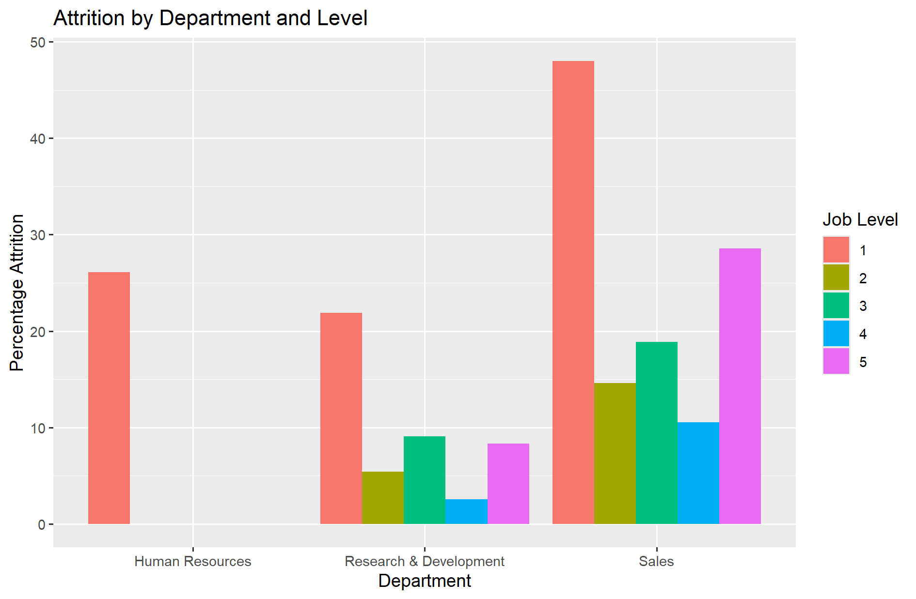
Attrition Summary - Percentages
Sales has highest attrition percentage
Job level 1 has the highest attrition followed by job level 5
Mid-career employees seem less likely to leave
For job level 1 is career growth an issue? Let’s look further.

Slide 4
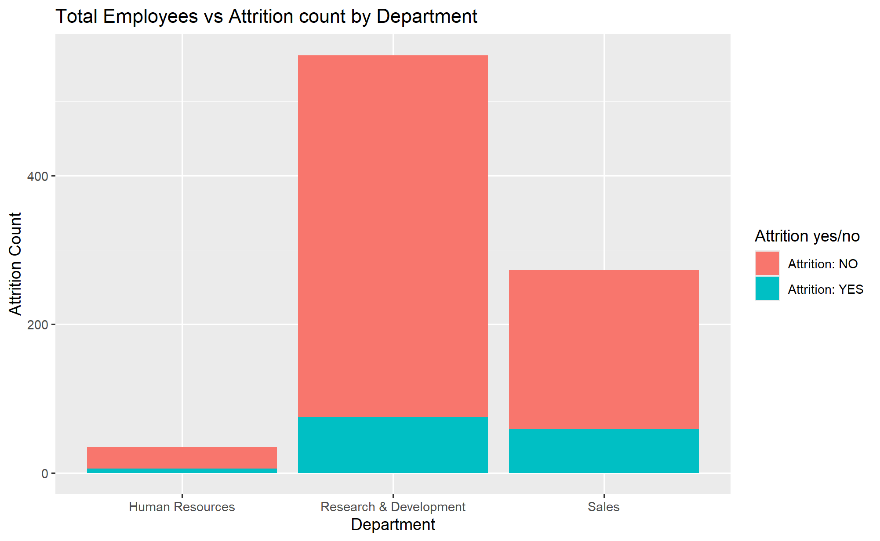
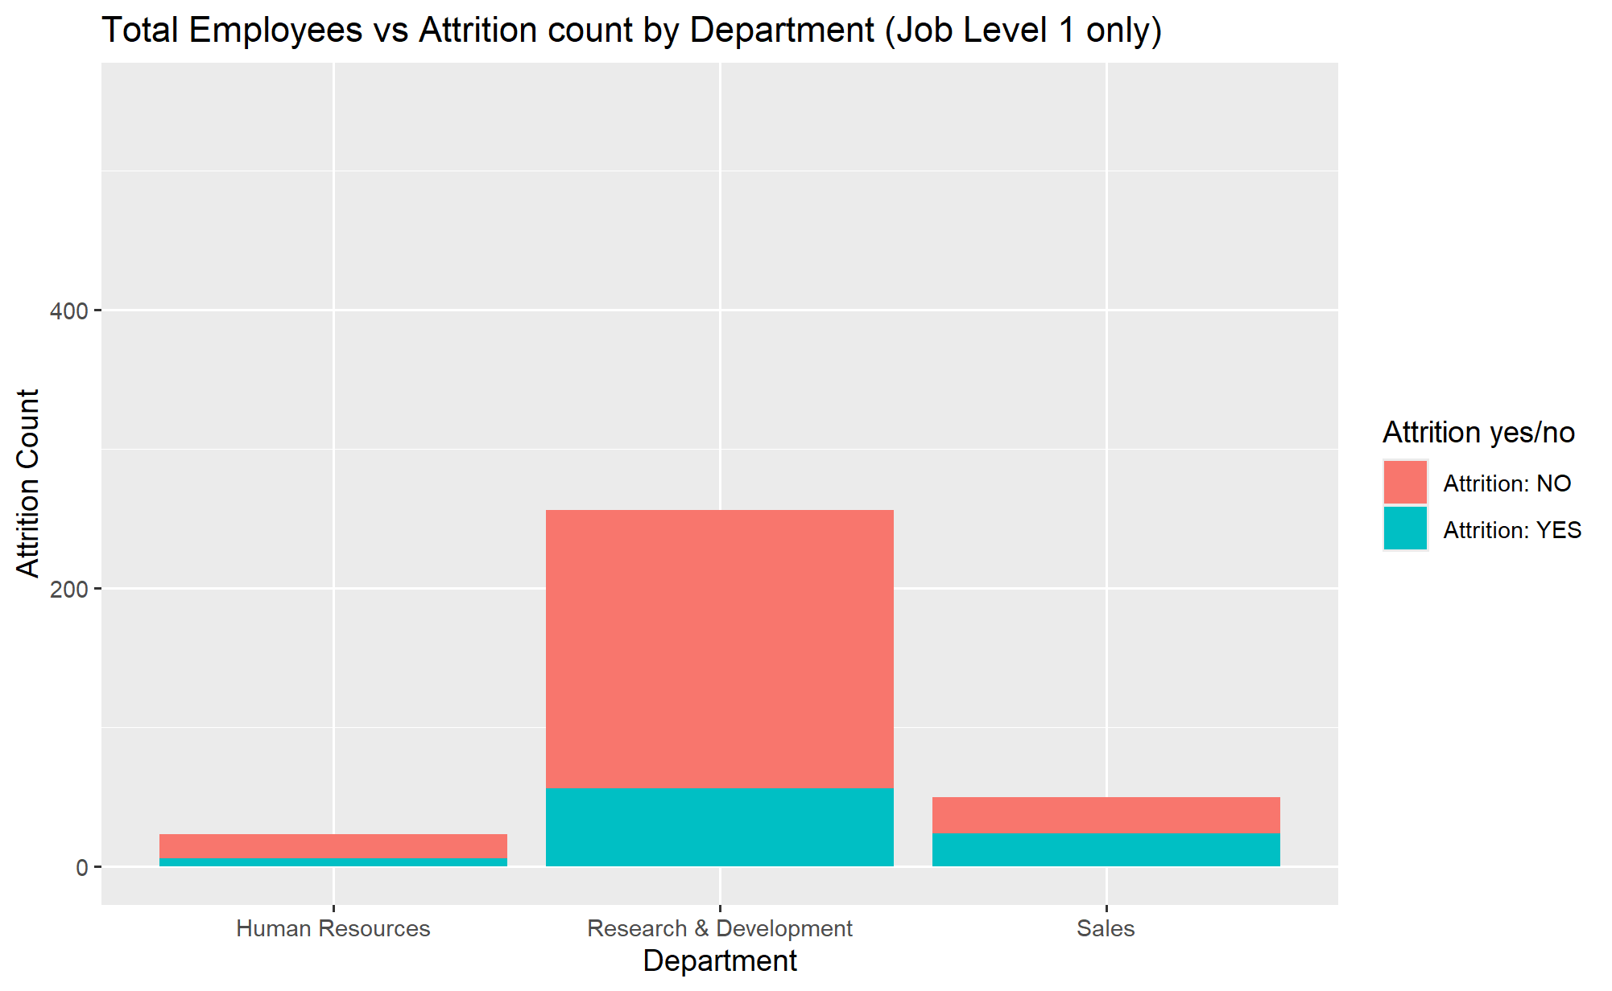
Attrition Summary – Total Counts
Looking at actual counts not percentages
R&D has highest number of employees and attrition only slightly higher than Sales
R&D employees are more likely to stay

Slide 5
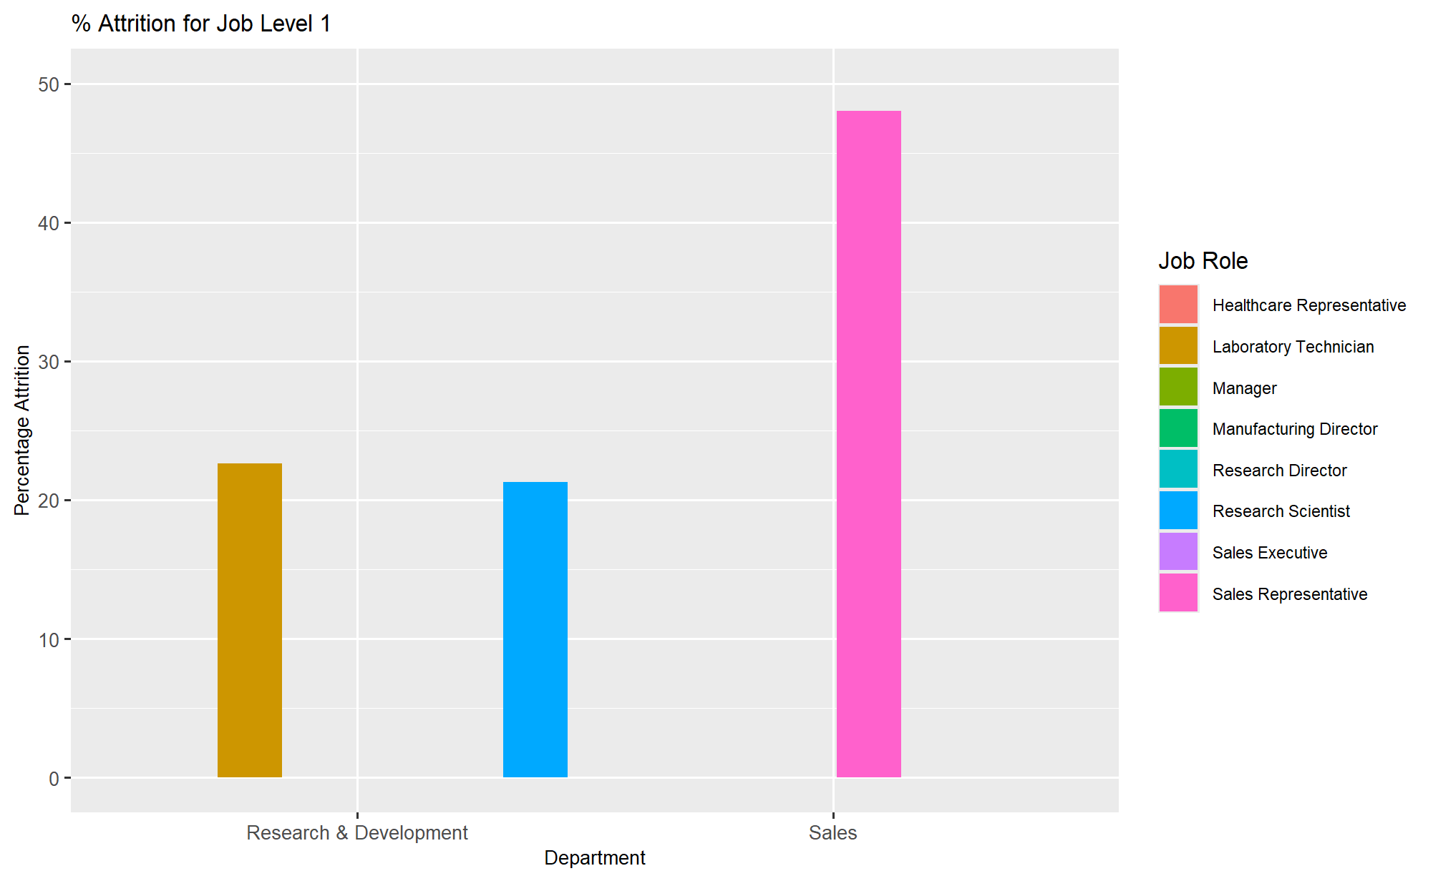
Attrition Details – By Job Role, Level - 1
Job Level 1 is most affected: “Sales Representative” is the maximum across groups.

Slide 6
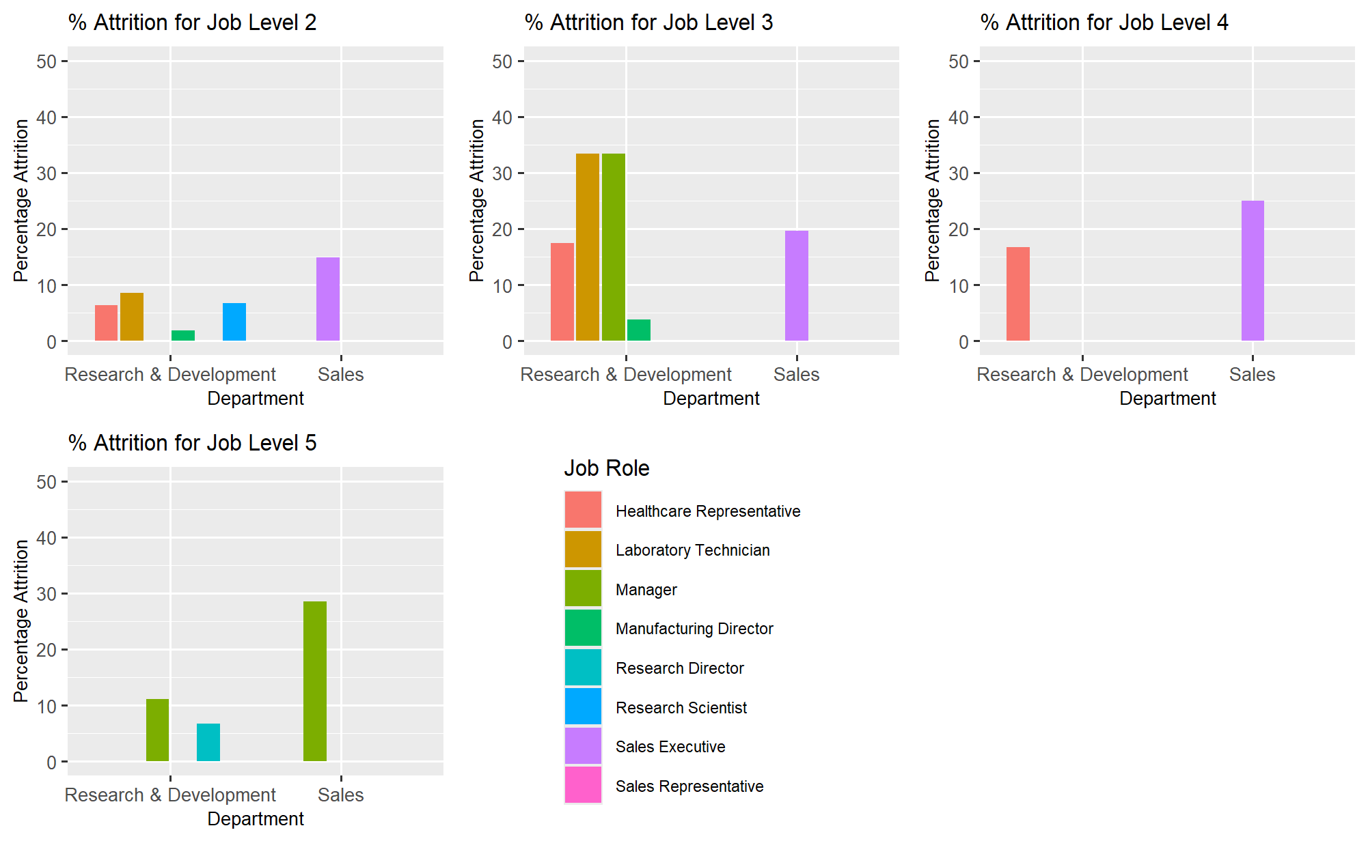
Attrition Details – By Job Role, Other levels
“Sales Executives” are also affected at other levels
R&D has a broader spread of attrition across roles but mostly at job level 3
Note: No “Sales representatives” at job levels > 1. This is then could be a mostly junior role.

Slide 7
Attrition Analysis – Looking at job levels
Let’s look at Job Level 3 in R&D and Job Level 1 in Sales.
Only 3 Sales Representatives
at Job Levels > 1
No Sales Executives
at Job Level 1
Possibly the junior Sales Representatives either leave or get promoted
Sales Executive appears to be the next role as no such role is present at job level 1.
Sales Executives also have attrition but much less. The attrition percent increases with level.
This can be a career growth path issue for these two sales roles
Let’s look at attrition counts for Sales Managers, job level 3.
18 Sales Managers across job levels
Only 2 Sales Managers have quit in the sample
So, only 18 managers with very little attrition.
Growth path could indeed be an issue in this sample.

Slide 8
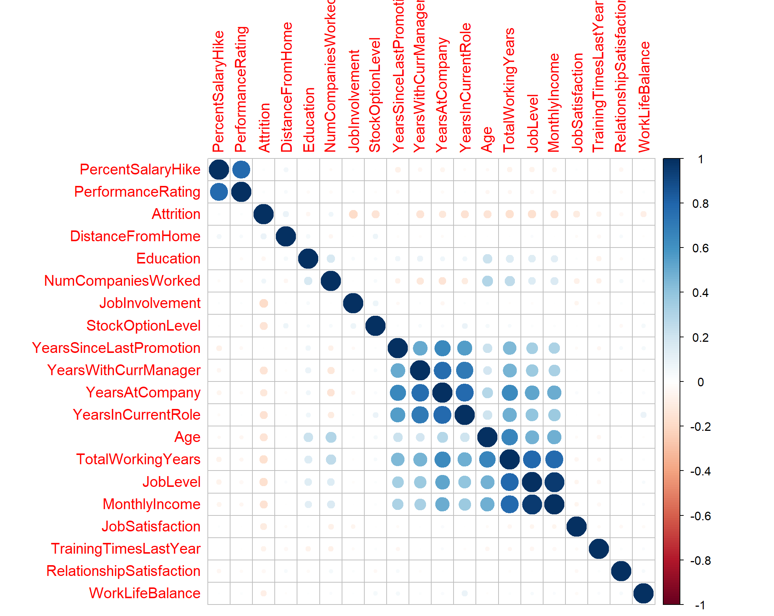
Numeric Correlations
Pairwise Pearson correlations. Attrition underlined.
Inverse correlations seen with several items like JobInvolveMent, StockOptionLevel etc. – Seems obvious
Larger Stock Options will result in less attrition for example.
Top numeric correlations:
JobInvolvement
TotalWorkingYears
JobLevel

Slide 9
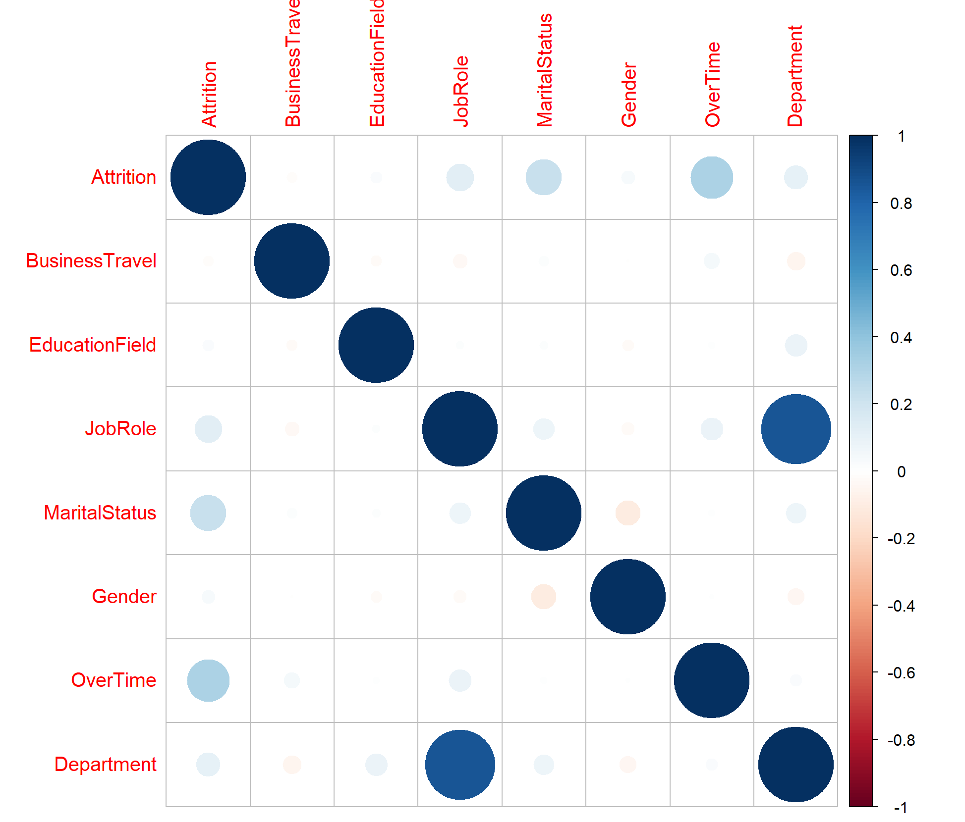
Non-Numeric Correlations
Pairwise Polychorric correlations. Attrition underlined.
Positive correlations seen with JobRole, MaritalStatus and OverTime
Correlation with Marital Status is interesting!
The column factor levels are Divorced, Married and Single.
So, Single employees are more likely to leave
OverTime seems to be a strong contributory factor.
Column factors levels are No, Yes.
So, employees subject to overtime are likely to leave

Slide 10
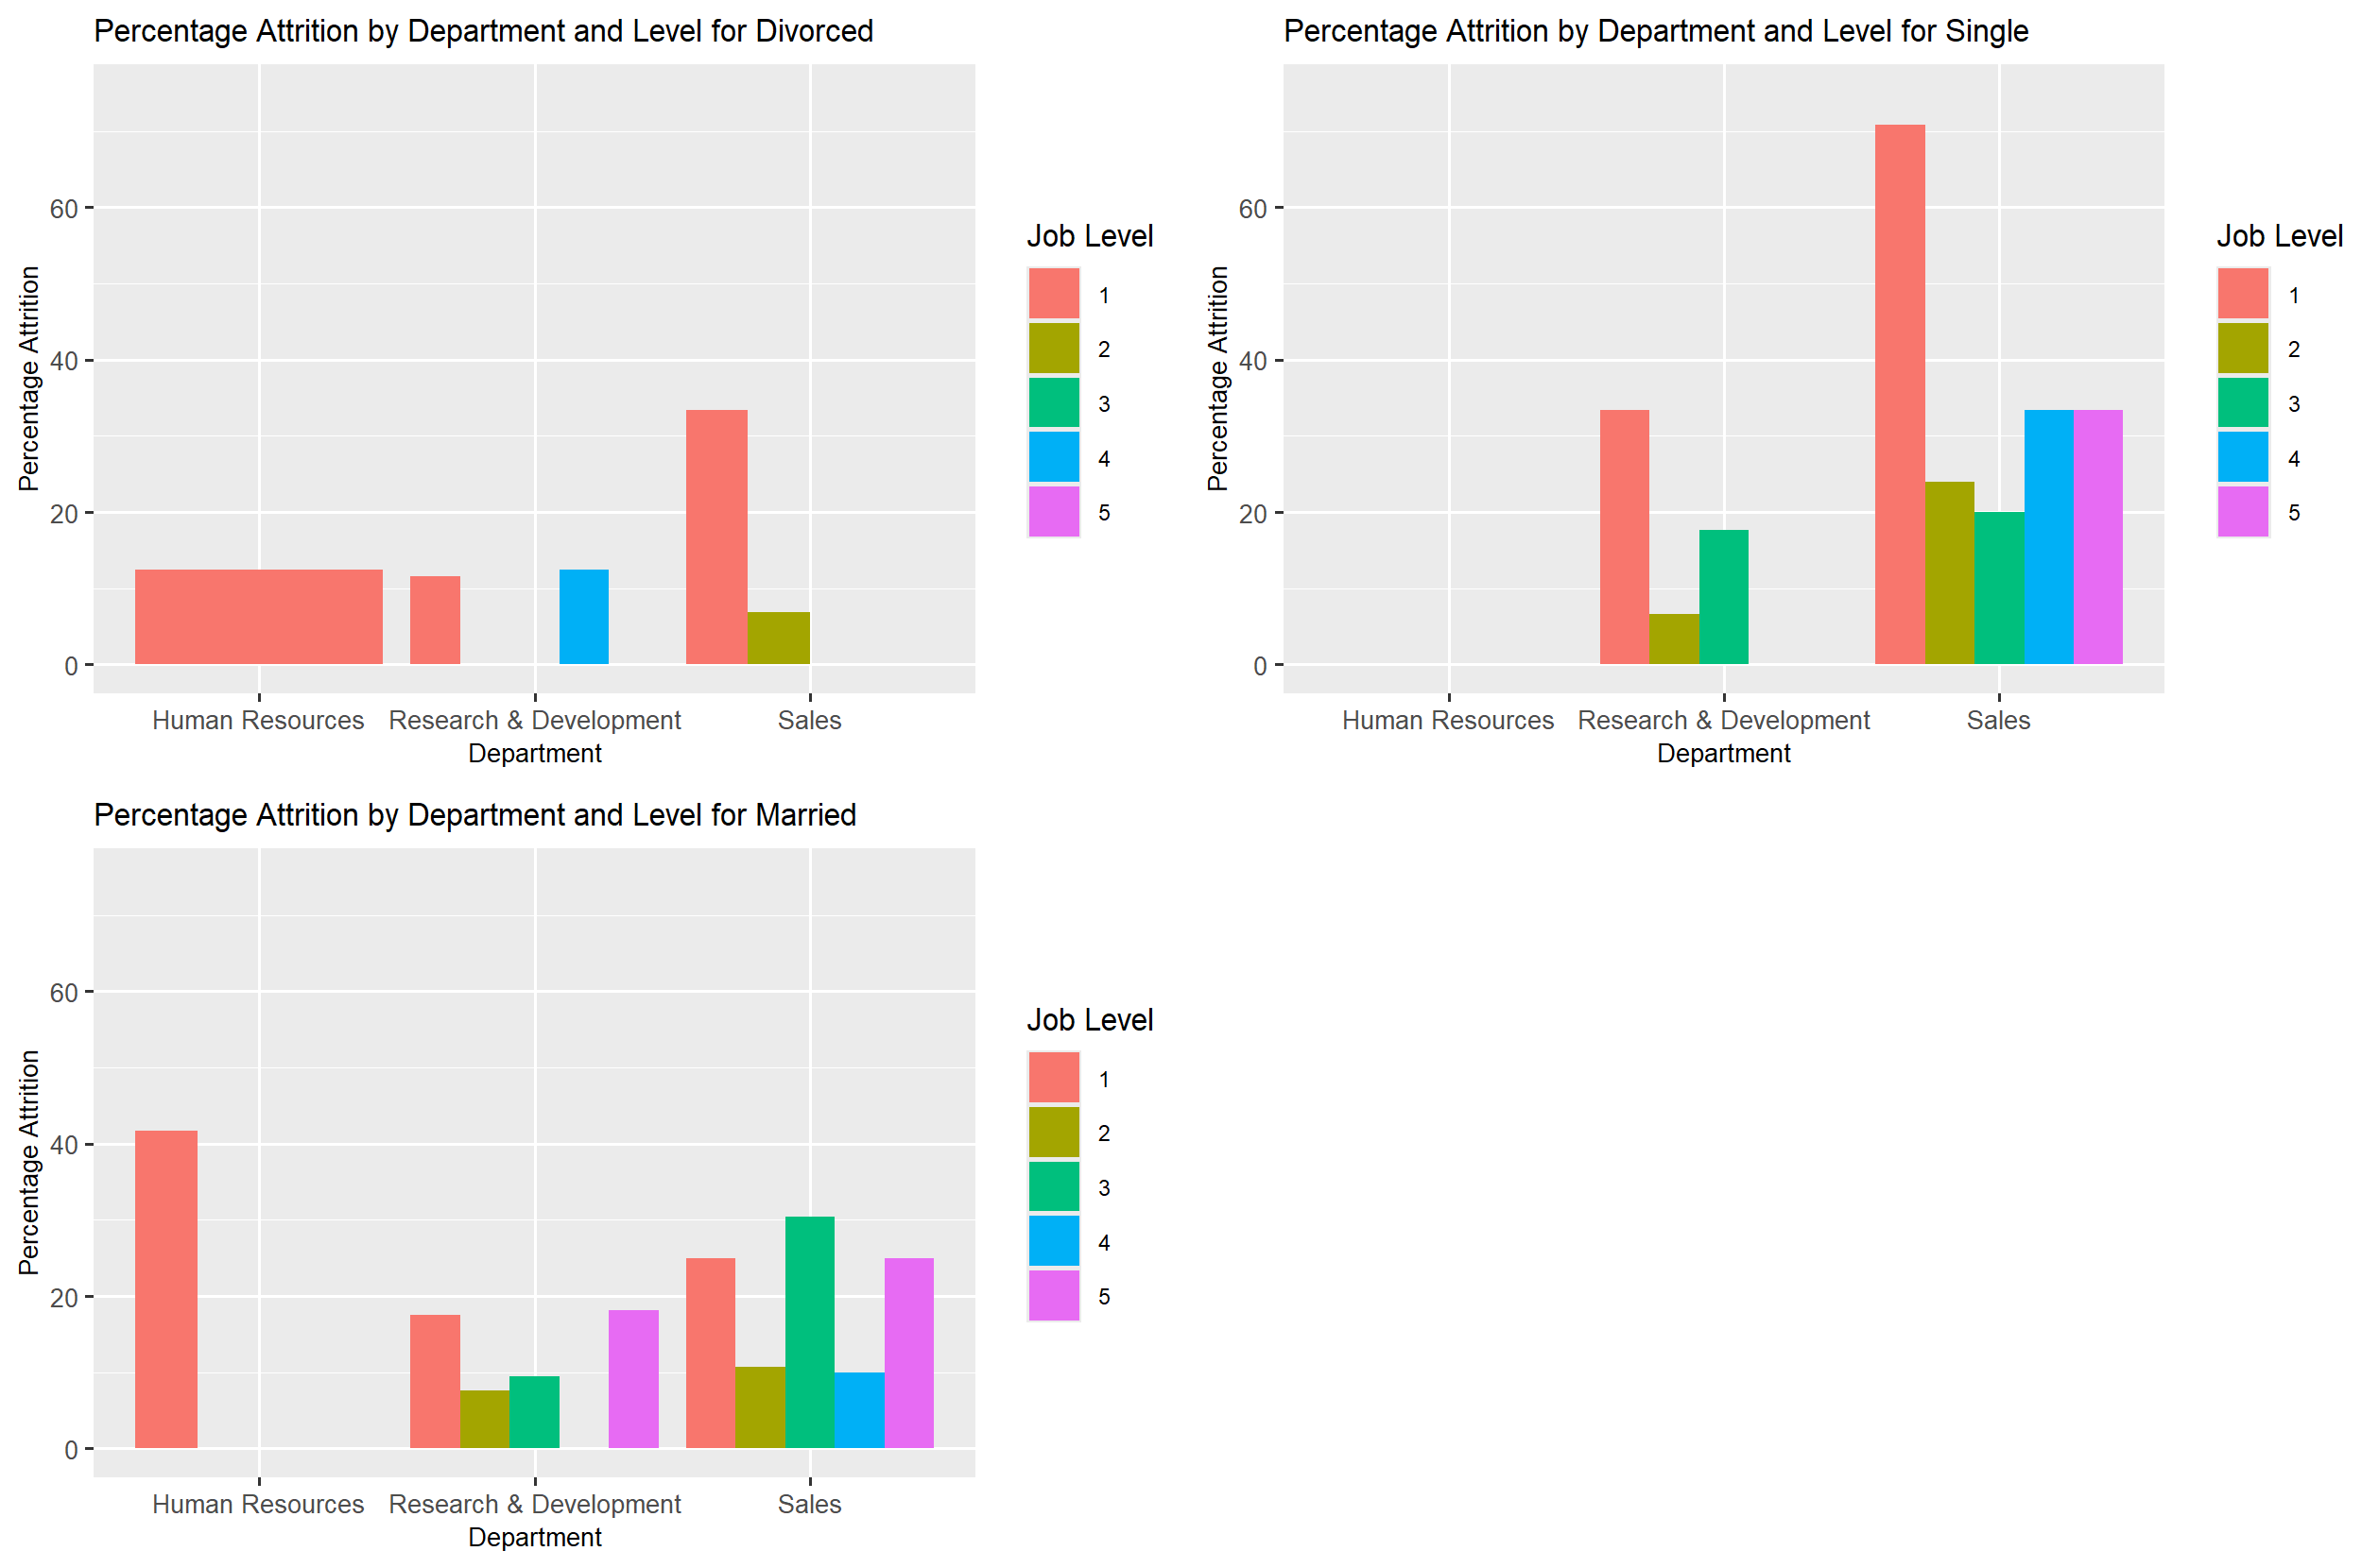
Looking at Marital Status
Single Employees have highest percentage of attrition across groups
Surprisingly, Human Resources has high attrition for Married!
Has no attrition for single.
Open question: Is it a data issue?

Slide 11
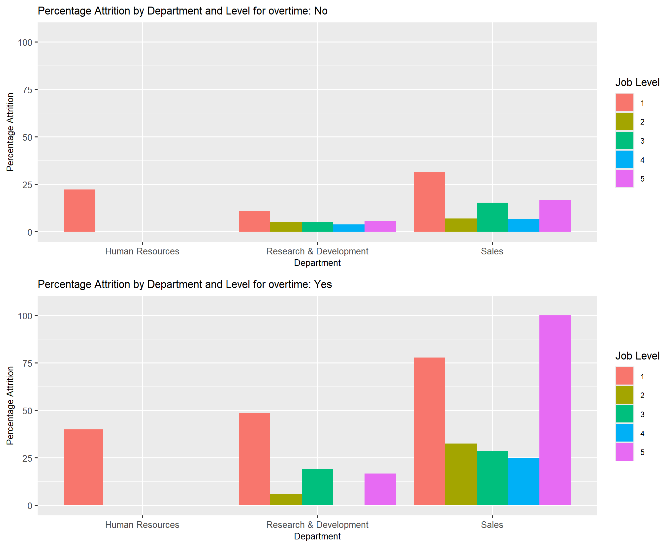
Looking at OverTime
Employees subject to overtime are more likely to leave.
Senior Sales employees do not like overtime at all!

Slide 12
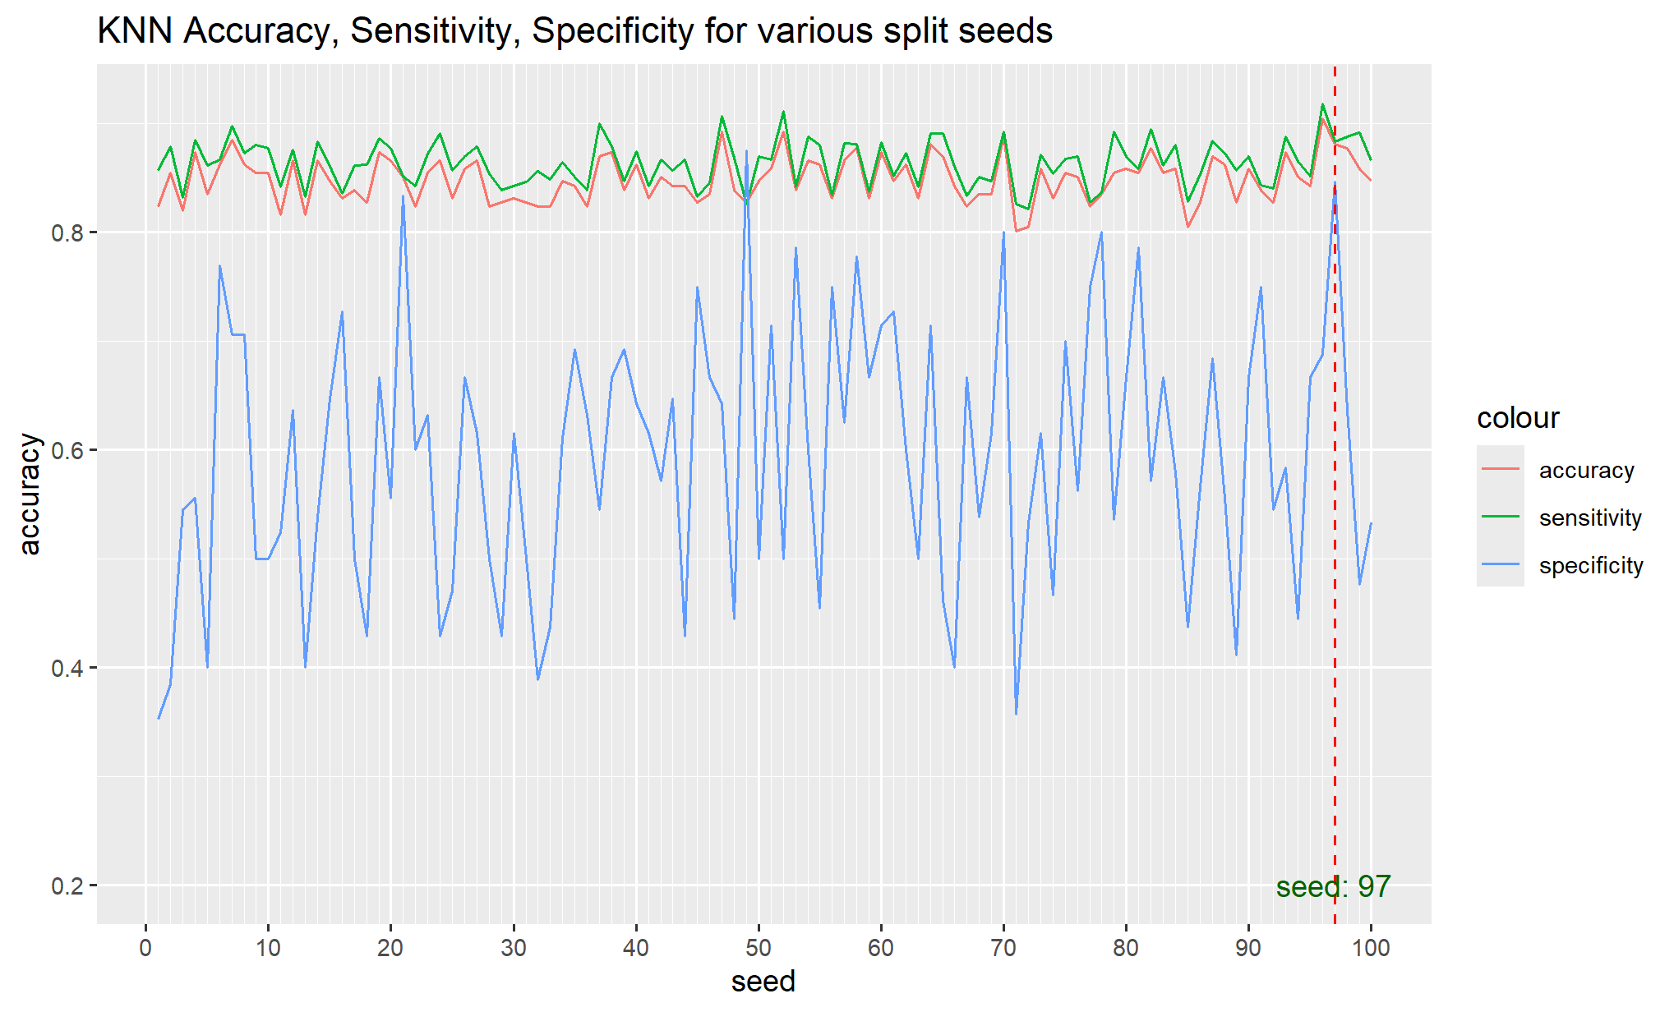
KNN Model
Confusion matrix for KNN model to predict Attrition with k = 5
classifications
0 1
0 219 2
1 29 11
Accuracy : 0.8812
95% CI : (0.8357, 0.9179)
Sensitivity : 0.8831
Specificity : 0.8462
KNN graph shows variance of the parameters with different seeds.

Slide 13
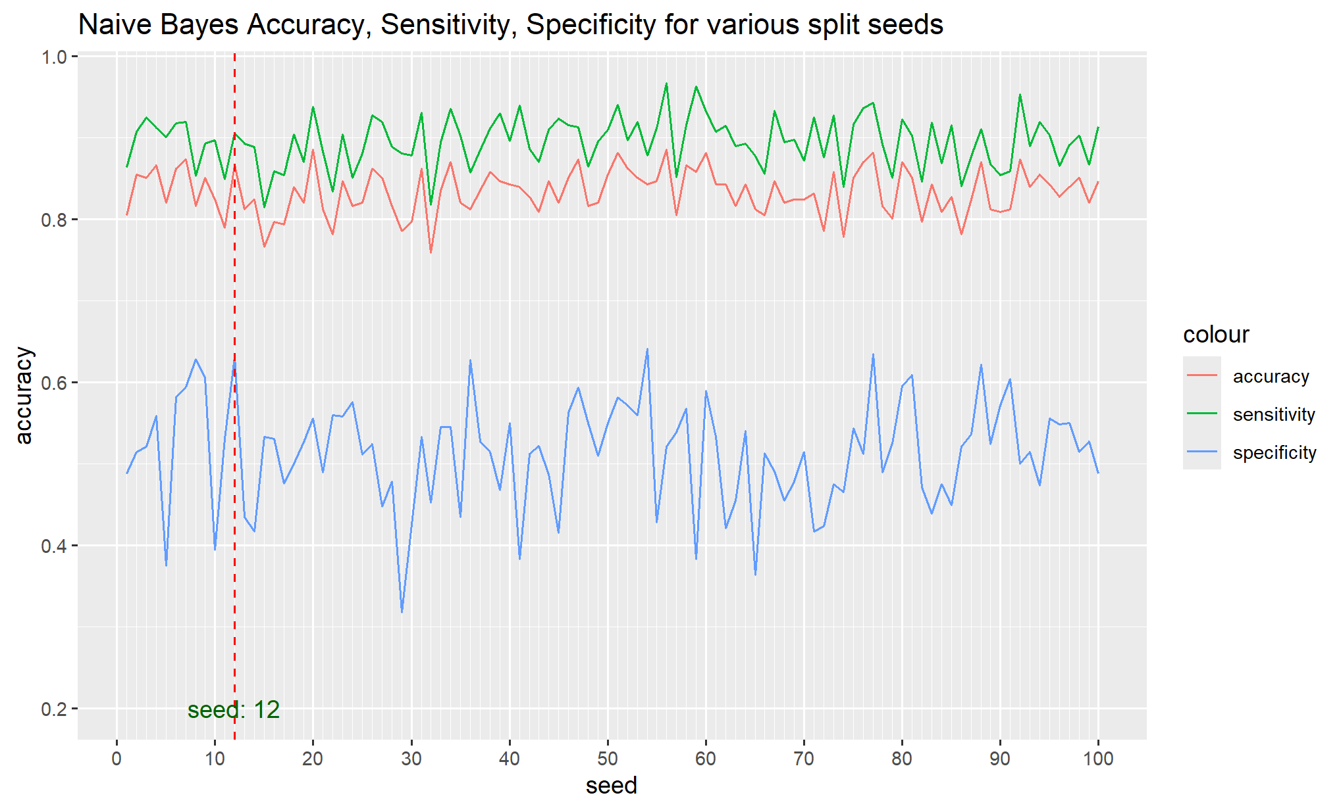
Naïve Bayes Model
Confusion matrix for Naïve Bayes model to predict Attrition
0 1
0 202 14
1 21 24
Accuracy : 0.8659
95% CI : (0.8185, 0.9048)
Sensitivity : 0.9058
Specificity : 0.6316

Slide 14
KNN Evaluation
classifications
0 1 Sensitivity : 88%
0 219 2 Specificity : 84%
1 29 11
Sensitivity: It is estimated that this model will predict 88% of those that will not leave (no attrition)
Specificity: It is estimated that this model will predict 84% of those that will leave (attrition)
The cost associated with this model 2 * 2.5 * 6390 + 29 * 200 + 11 * 200 = $39950

Slide 15
Naïve Bayes Evaluation
classifications
0 1 Sensitivity : 90%
0 202 14 Specificity : 63%
1 21 24
Sensitivity: It is estimated that this model will predict 90% of those that will not leave (no attrition)
Specificity: It is estimated that this model will predict 63% of those that will leave (attrition)
The cost associated with this model 14 * 2.5 * 6390 + 21 * 200 + 24 * 200 = $232650
0 – No Attrition
1 – Attrition
So, it is better to be able to detect employees leaving as opposed to those not leaving. A greater specificity is more important for this model. From that perspective the KNN model is a lower cost model.

Slide 16
Conclusions
The Sales department has the largest percentage of attritions.
R&D has a larger absolute number of people leaving but overall employee count is high.
Sales attritions are concentrated in Level 1 and Level 5 employees
Some of the indicative reasons from the sample could be:
Career growth
Overtime challenges
Job Level and Marital status
Married people are more likely to stay back
Level 5 attrition in Sales looks strongly correlated to Overtime
KNN requires a few selected explanatory variables to be effective
Naïve Bayes works well with more explanatory variables unlike KNN

Slide 17
Questions ? Moinak Ghosh

